Slide 1
EMOJI AND CONTEXT–AWARE TWEETS CLASSIFICATION USING LSTM AND Bi-LSTM
IF3311 PROJECT PHASE - I
Presented By
JANANI GOPALAKRISHNAN (2023611026)
Under the Guidance of
Dr. P.ANANDHA KUMAR, PROFESSOR,
Department of Information Technology, MIT

Slide 2
PROBLEM STATEMENT
Hate speech on social media platforms, particularly in event-specific datasets like the Olympics 2024 tweets, is a pressing issue that impacts user experience and societal harmony.
Existing models often fail to incorporate contextual and nuanced features like emoji embeddings and multi-dimensional clustering techniques, leading to limited classification accuracy.
This project aims to address these gaps by leveraging advanced feature extraction techniques (GloVe embedding, emoji embedding, N-grams) and deep learning models (LSTM, Bi-LSTM), further enhanced with DBSCAN clustering and an attention mechanism, to achieve context-aware classification of hate speech in tweets.
PROPOSED SYSTEM

Slide 3
LITERATURE SURVEY
S.No | TITLE | METHODOLOGY | ADVANTAGES | LIMITATIONS
1 | Detection of Hateful Twitter Users with Graph Convolutional Network Model | Graph Convolutional Network (GCN) to detect hateful users on Twitter with accuracy of 93%. | High Accuracy, Effective Analysis, User Data Integration. | Complex and computationally heavy O(e + n), Data quality dependent, Limited to twitter
2 | Deep LSTM with Attention for Message-Level and Topic-Based Sentiment Analysis | Deep LSTM with Attention for sentiment analysis, achieving 88% in SemEval-2017 Task 4 datasets. | Captures long-term dependencies using LSTM. Incorporates attention mechanisms for relevance. | Computationally expensive.- Performance depends on the quality of the attention mechanism tuning.
3 | Hate Speech and Offensive Content Identification with Graph Convolutional Networks | Graph Convolutional Networks (GCN) for context-based content detection achieving 71.94% and 78.95% with Hindi and Marathi datasets. | Context-aware analysis, effective with offensive content | Requires structured data for GCNs, high model complexity

Slide 4
S.No | TITLE | METHODOLOGY | ADVANTAGES | LIMITATIONS
4 | Hate Speech and Offensive Content Identification in English and Indo-Aryan Languages | Variety of Machine Learning and Deep Learning models, using Marathi, Hindi and English Tweets from Twitter. | Supports multiple languages, extensive benchmarking. | Benchmark focus may not reflect real-world efficiency
5 | Deep LSTM with Attention for Sentiment Analysis | LSTM with attention mechanism | Mechanism improves model interpretability | Limited to sentiment analysis, can be computationally expensive
6 | Hate Speech Detection on Twitter Using BERT Algorithm | BERT model for hate speech detection on Twitter, achieving 78.69%. | High accuracy with BERT, effective for text-rich environments | Requires large datasets for fine-tuning, complex preprocessing

Slide 5
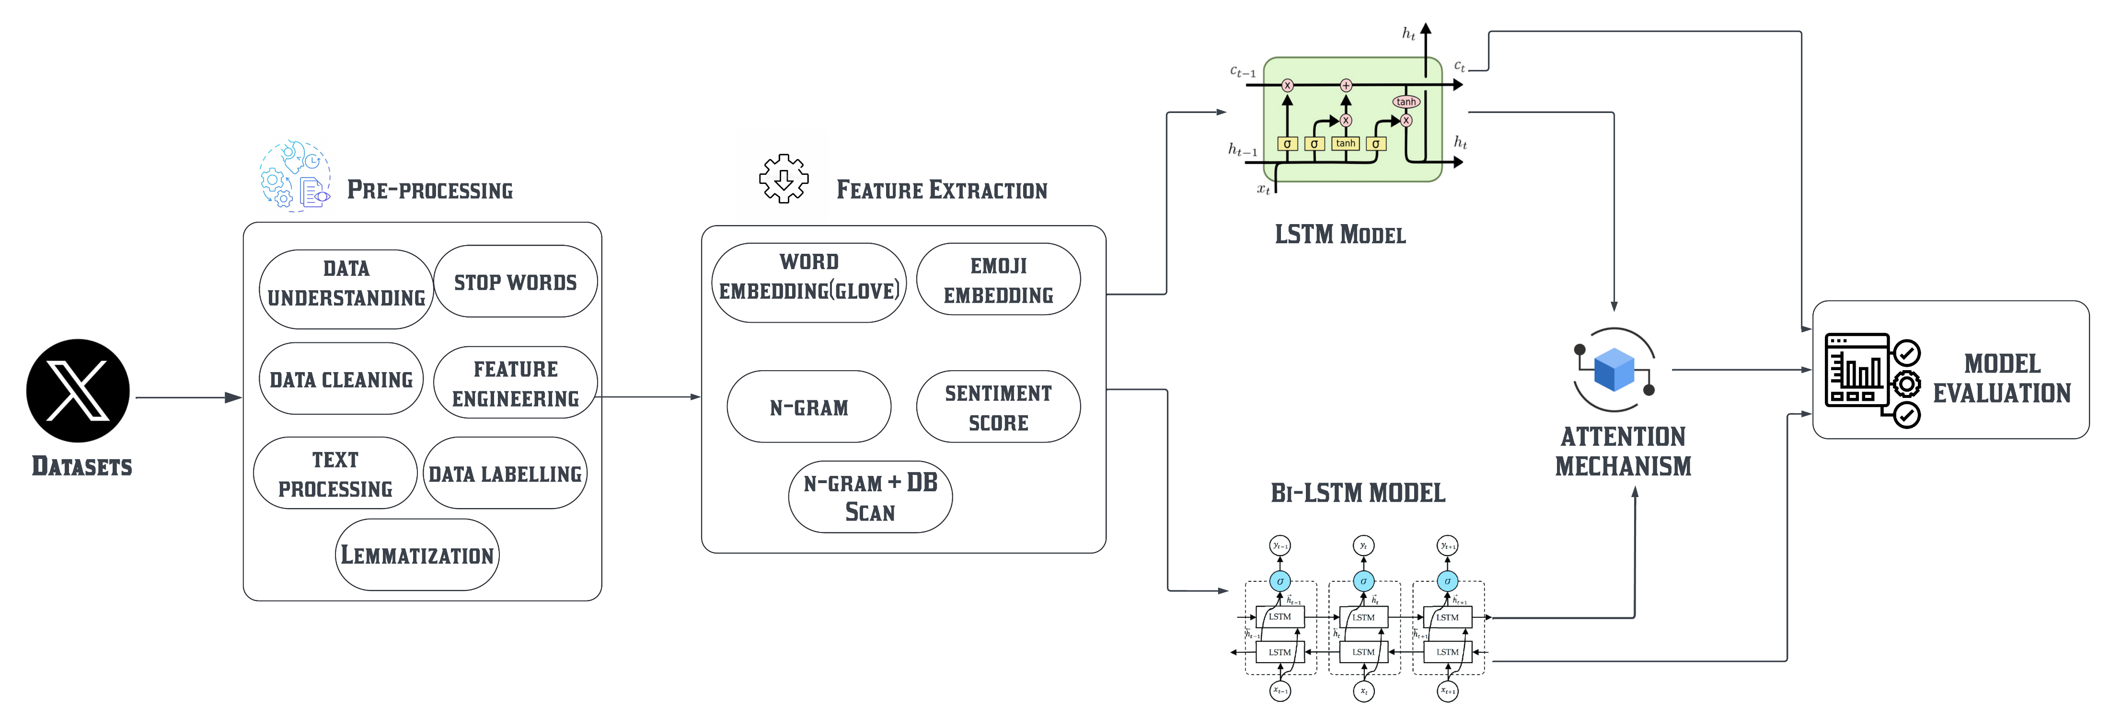
SYSTEM ARCHITECTURE

Slide 6
SYSTEM REQUIREMENTS
Developer Platform: Jupyter Notebook - The primary interactive environment for writing, testing, and visualizing code and models.
Programming Language: Python 3.x.
Libraries and Frameworks:
Pandas: For data manipulation, cleaning, and handling CSV files.
NumPy: For numerical operations and efficient array manipulations.
NLTK (Natural Language Toolkit): For stop word removal, tokenization, and basic text processing.
Scikit-learn: For extracting n-grams (bi-grams).
TensorFlow/Keras:For building and training deep learning models such as LSTM and Bi-LSTM.
Matplotlib and Seaborn: For visualizing model performance, loss curves, accuracy trends, and confusion matrices.
TensorFlow with CUDA/cuDNN: To enable GPU acceleration for faster model training and evaluation.
TensorFlow Callbacks: To optimize training using techniques like EarlyStopping and ReduceLROnPlateau.

Slide 7
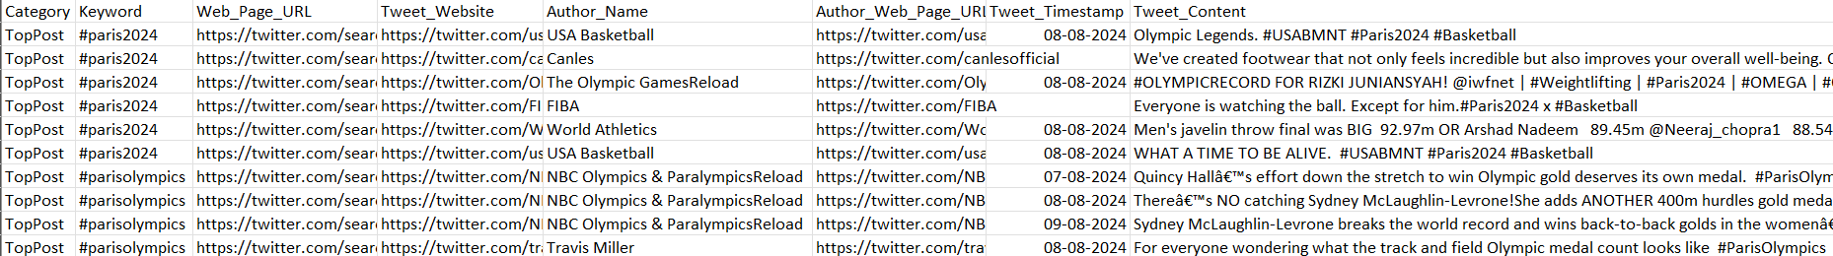
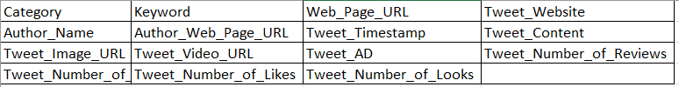
DATASET DESCRIPTION
Raw Data:
Total Number of data : 31,542
Attributes = 15
Train data = 80%
Test data = 20%
Class 0 = non-hate
Class 1 = hate

Slide 8
MODULE DESCRIPTION
Data Preprocessing and Feature Extraction:
This module prepares raw twitter tweets for effective hate speech detection.
Data Cleaning: Remove duplicates and Handling Missing Values.
Text Standardization: remove stop words, apply lemmatization to get root words and eliminating non-ASCII characters.
Emoji Transformation: Converting Text into Emoji, allowing model to interpret emotional clues in post.
Once the data is preprocessed, feature extraction generates inputs that enable the model to understand both text and emoji contexts.
Word Embeddings: Using GloVe embedding to convert words into vectors.
Emoji Embeddings: Convert emojis into descriptive vector forms, enhancing the model’s ability to understand non-verbal sentiment.
N-grams: Identify frequent bigrams (two-word phrases) that may indicate hate speech, improving detection accuracy.
Sentiment Scoring: Use Text-Blob to assign a sentiment score (-1 to 1) to each post, helping the model detect hate speech through tone analysis.

Slide 9
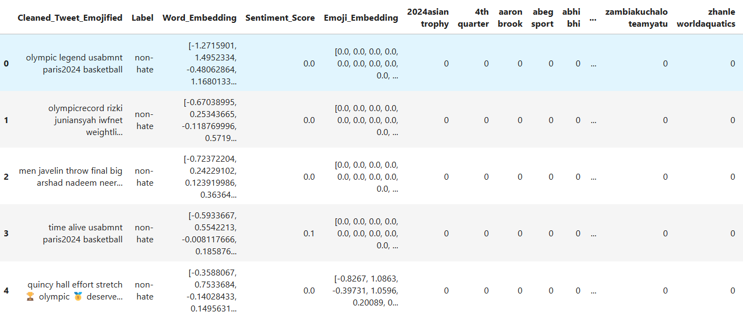
Feature Extraction

Slide 10
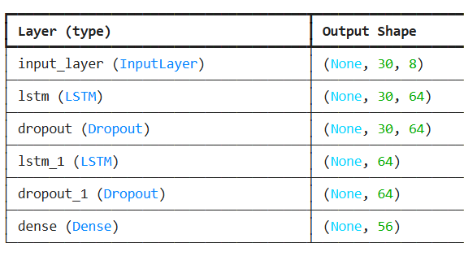
LSTM AND Bi-LSTM
Algorithm:
Input:
Dataset featured with word embedding(GloVe) and N-grams(Bi-grams).
Class labels
Process:
Data Preparation: Convert Word_Embedding to a 2D numpy array and encode Label into one-hot format. Split the data into training and testing sets (80-20 split). And using Bi-grams with Emoji.
Reshaping: Reshape feature arrays to make them compatible with the LSTM model by adding a timestep dimension.
Model Building: Define a LSTM-based model with 64 units, dense layers, dropout for regularization, and a softmax output layer for binary classification.
Training and Evaluation: Compile the model with Adam optimizer, train it on the training set, and validate on the test set. Evaluate accuracy, confusion matrix, and classification report.
Output:
Test Accuracy, Confusion Matrix and Classification report.
LSTM MODEL
To build and train deep learning models to detect hate speech using LSTM with Feature Extraction of Word Embedding(GloVe) and N-grams(Bi-grams).

Slide 11
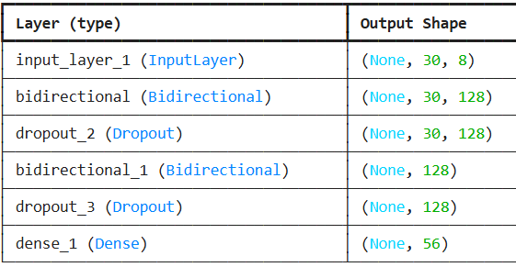
LSTM AND Bi-LSTM
Algorithm:
Input:
Dataset featured with word embedding(GloVe) and N-grams(Bi-grams).
Class labels
Process:
Data Preparation: Convert Word_Embedding to a 2D numpy array and encode Label into one-hot format. Split the data into training and testing sets (80-20 split). And using Bi-grams with Emoji.
Reshaping: Reshape feature arrays to make them compatible with the Bi-LSTM model by adding a timestep dimension.
Model Building: Define a Bi-LSTM-based model with 64 units, dense layers, dropout for regularization, and a softmax output layer for binary classification.
Training and Evaluation: Compile the model with Adam optimizer, train it on the training set, and validate on the test set. Evaluate accuracy, confusion matrix, and classification report.
Output:
Test Accuracy, Confusion Matrix and Classification report.
Bi-LSTM MODEL
To build and train deep learning models to detect hate speech using Bi-LSTM with Feature Extraction of Word Embedding(GloVe) and N-grams(Bi-grams).

Slide 12
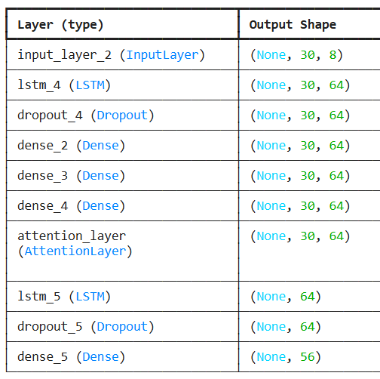
LSTM AND Bi-LSTM MODEL WITH DB SCAN CLUSTERING AND ATTENTION MECHANISM
Algorithm:
Input:
Dataset featured with word embedding(GloVe) and N-grams(Bi-grams).
Class labels
Process:
Convert word embeddings (GloVe) to a 2D numpy array. And using Bi-grams with Emoji.
Perform DBSCAN clustering on the features for grouping and noise detection.
Reshape feature arrays to fit the LSTM model (adding timestep dimension).
Implement an attention mechanism to focus on important sequence features.
Build a LSTM model with 64 units, dense layers, dropout, attention, and softmax for binary classification. Train and evaluate using accuracy, confusion matrix, and classification report.
Output:
Test Accuracy, Confusion Matrix and Classification report.
LSTM MODEL
To build and train deep learning models to detect hate speech using LSTM with Feature Extraction of Word Embedding(GloVe) and N-grams(Bi-grams) with DB Scan and Attention Mechanism.

Slide 13
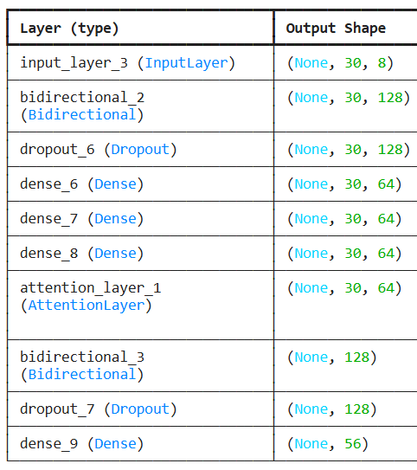
LSTM AND Bi-LSTM MODEL WITH DB SCAN CLUSTERING AND ATTENTION MECHANISM
Algorithm:
Input:
Dataset featured with word embedding(GloVe) and N-grams(Bi-grams).
Class labels
Process:
Convert word embeddings (GloVe) to a 2D numpy array. And using Bi-grams with Emoji.
Perform DBSCAN clustering on the features for grouping and noise detection.
Reshape feature arrays to fit the Bi-LSTM model (adding timestep dimension).
Implement an attention mechanism to focus on important sequence features.
Build a Bi-LSTM model with 64 units, dense layers, dropout, attention, and softmax for binary classification. Train and evaluate using accuracy, confusion matrix, and classification report.
Output:
Test Accuracy, Confusion Matrix and Classification report.
Bi-LSTM MODEL
To build and train deep learning models to detect hate speech using Bi-LSTM with Feature Extraction of Word Embedding(GloVe) and N-grams(Bi-grams) with DB Scan and Attention Mechanism.

Slide 14
LSTM AND Bi-LSTM MODEL WITH DB SCAN CLUSTERING AND ATTENTION MECHANISM
DB Scan Clustering with Word Embedding(GloVe)

Slide 15
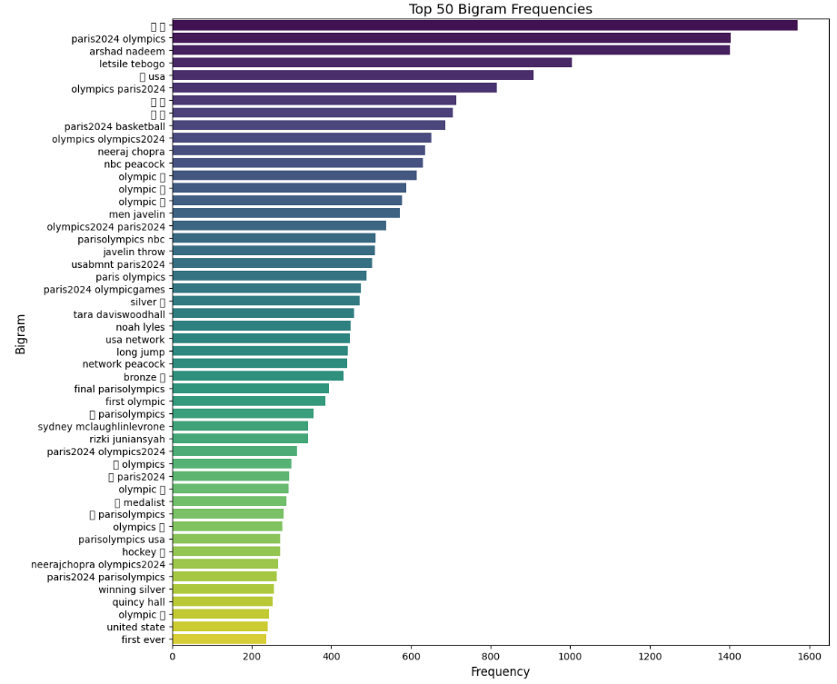
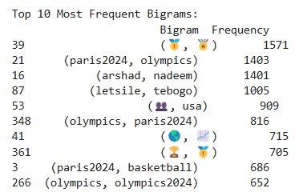

Slide 16
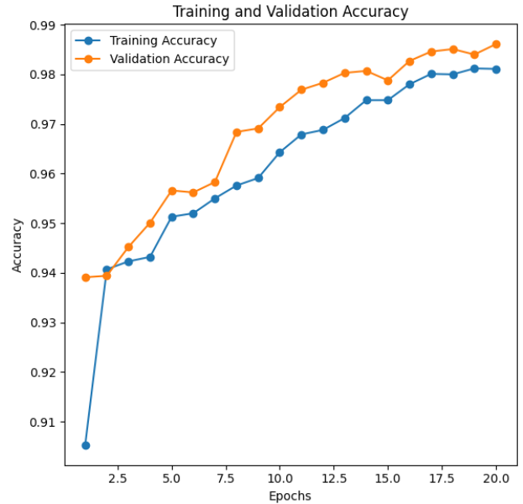
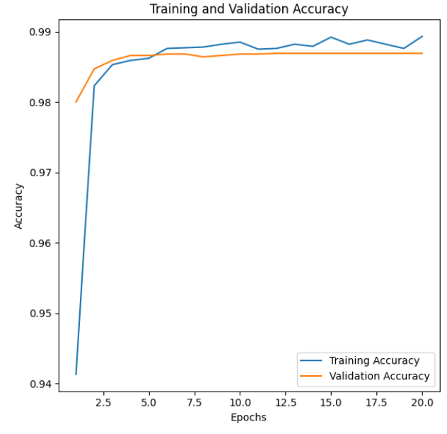
RESULTS AND DISCUSSION
LSTM
Word Embedding (GloVe): Accuracy: 98.11%
 | Precision | Recall | F1-score
0 (non-Hate) | 0.99 | 0.85 | 0.91
1(Hate) | 0.99 | 1.00 | 0.99
With N-grams (Bi-grams): Accuracy – 98.93%
 | Precision | Recall | F1-score
0 (non-Hate) | 1.00 | 0.79 | 0.88
1(Hate) | 0.99 | 1.00 | 0.99

Slide 17
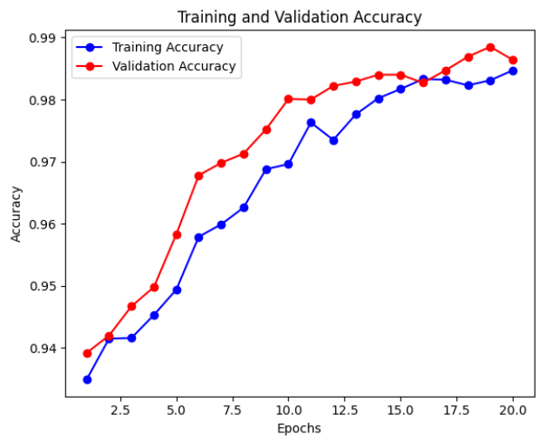
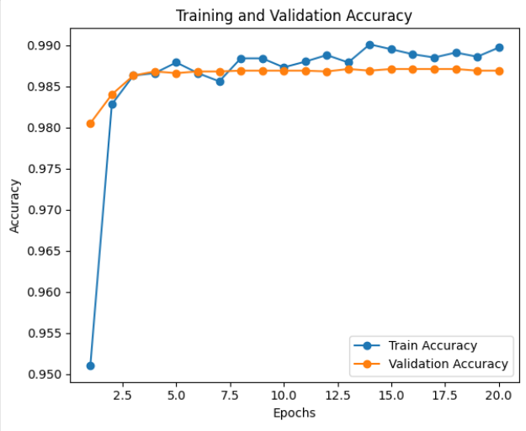
RESULTS AND DISCUSSION
Bi-LSTM
Word Embedding (GloVe): Accuracy: 98.47%
 | Precision | Recall | F1-score
0 (non-Hate) | 0.98 | 0.80 | 0.88
1(Hate) | 0.99 | 1.00 | 0.99
With N-grams (Bi-grams): Accuracy – 98.97%
 | Precision | Recall | F1-score
0 (non-Hate) | 1.00 | 0.79 | 0.88
1(Hate) | 0.99 | 1.00 | 0.99

Slide 18
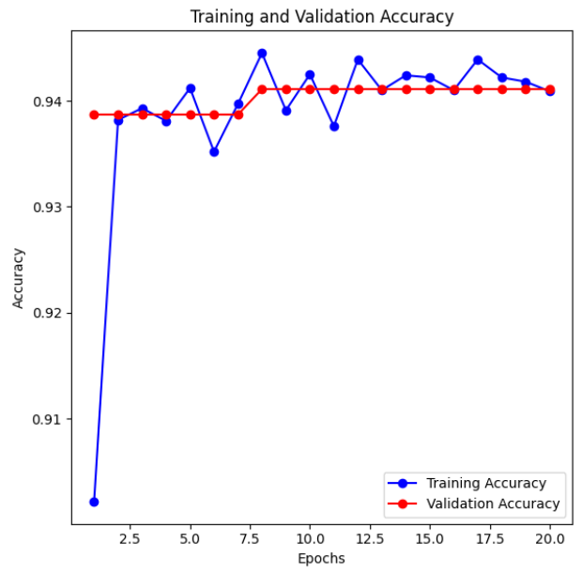
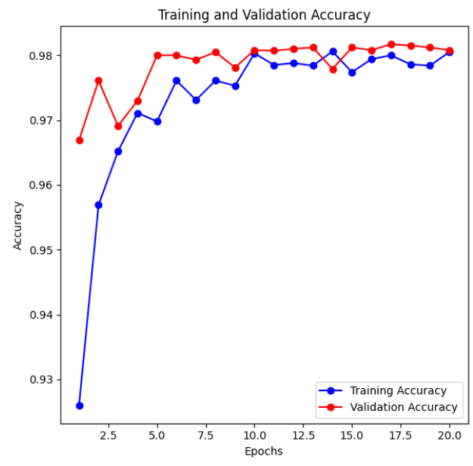
RESULTS AND DISCUSSION
LSTM WITH DB SCAN AND ATTENTION MECHANISM
Word Embedding (GloVe): Accuracy – 93.86%
 | Precision | Recall | F1-score
0 (non-Hate) | 0.00 | 0.00 | 0.00
1(Hate) | 0.94 | 1.00 | 0.97
With N-grams (Bi-grams): Accuracy – 98.05%
 | Precision | Recall | F1-score
0 (non-Hate) | 0.99 | 0.69 | 0.82
1(Hate) | 0.98 | 1.00 | 0.99

Slide 19
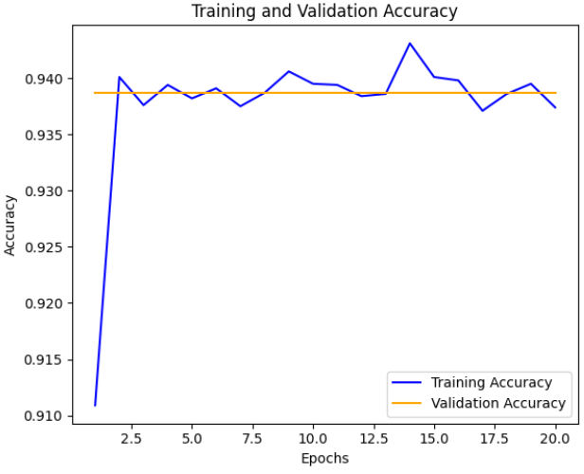
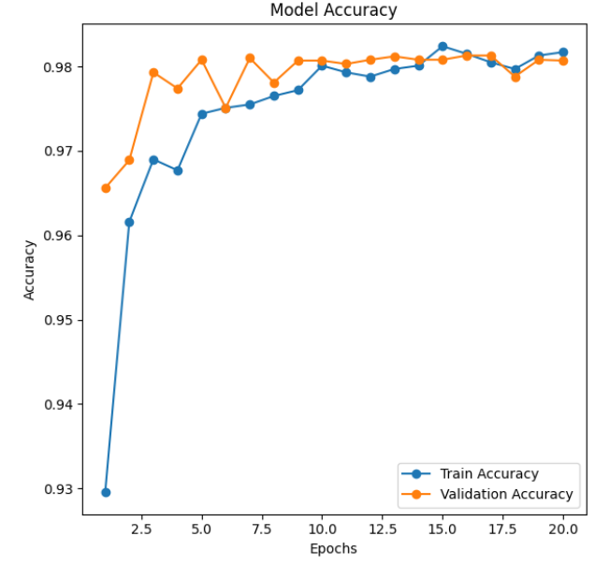
RESULTS AND DISCUSSION
Bi-LSTM WITH DB SCAN AND ATTENTION MECHANISM
Word Embedding (GloVe): Accuracy – 93.74%
 | Precision | Recall | F1-score
0 (non-Hate) | 0.00 | 0.00 | 0.00
1(Hate) | 0.94 | 1.00 | 0.97
With N-grams (Bi-grams): Accuracy – 98.17%
 | Precision | Recall | F1-score
0 (non-Hate) | 0.98 | 0.70 | 0.81
1(Hate) | 0.98 | 1.00 | 0.99

Slide 20
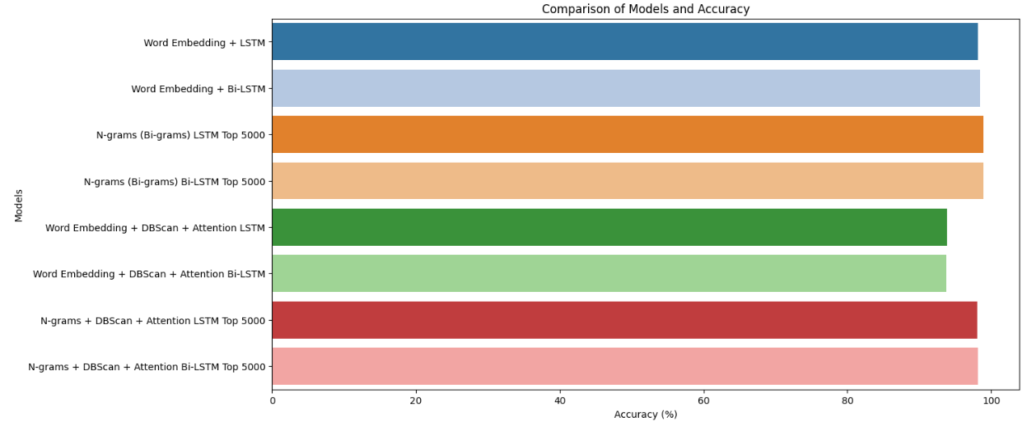
MODEL | ACCURACY
LSTM (GloVe) | 98.11%
LSTM (Bi-grams) | 98.93
Bi-LSTM(GloVe) | 98.47
Bi-LSTM(Bi-grams) | 98.97
LSTM + DB Scan+ Attention Mechanism (GloVe) | 93.86
LSTM + DB Scan+ Attention Mechanism (Bi-grams) | 98.05
Bi-LSTM + DB Scan+ Attention Mechanism (GloVe) | 93.74
Bi-LSTM + DB Scan+ Attention Mechanism (Bi-grams) | 98.17

Slide 21
CONCLUSION
This project demonstrates detecting hate speech in Olympics datasets in LSTM and Bi-LSTM with or without DB Scan clustering and Attention Mechanism.
Comparative experiments demonstrated that Bi-LSTM models consistently outperformed LSTM due to their ability to capture bidirectional dependencies.
Word embeddings with Bi-LSTM achieved higher accuracy 98.47% than LSTM 98.11%, while N-grams (Bi-grams) with the top 5000 features yielded the best performance: 98.97% for Bi-LSTM and 98.93% for LSTM.
With DB Scan and Attention Mechanism with word embeddings delivering lower accuracy 93.86% for LSTM and 93.74% for Bi-LSTM.
There also another analyze with N-grams (Bi-grams) with top 10 features Bi-LSTM achieved higer accuracy 94.47% than LSTM 94.07%.
With evaluating all Bi-LSTM model performed well than LSTM model.

Slide 22
FUTURE WORK
Future research can extend this work in the following directions:
Implement advanced architectures such as Transformers or Hybrid Models to improve performance and capture complex relationships in the data.
By exploring other feature extraction like Linguistic feature such as syntactic dependencies, word frequencies, and topic modelling.
Implementing Transfer Learning with pre-trained models like RoBERTa and GPT with fine-tuning on the dataset to handle complex hate speech patterns more effectively.
Developing a real-time hate speech detection system to analyze social media content dynamically.

Slide 23
REFERENCES
[1] U. Ahmed and J. C.-W. Lin, "Deep explainable hate speech active learning on social-media data", IEEE Trans. Computat. Social Syst., Apr. 2022.
[2] Alsafari, S., Sadaoui, S., Mouhoub, M., 2020. “Hate and offensive speech detection on Arabic social media”. Online Soc. Netw. Media 19, 100096.
[3] S. S. Aluru, B. Mathew, P. Saha, A. Mukherjee, “Deep learning models for multilingual hate
speech detection”, arXiv preprint arXiv:2004.06465 (2020).
[4] T. Mandl, S. Modha, G. K. Shahi, H. Madhu, S. Satapara, P. Majumder, J. Schäfer, T. Ranas-inghe, M. Zampieri, D. Nandini, A. K. Jaiswal, Overview of the HASOC subtrack at FIRE 2021: “Hate Speech and Offensive Content Identification in English and Indo-Aryan Languages”, in: Working Notes of FIRE 2021 - Forum for Information Retrieval Evaluation, CEUR, 2021.
[5] C. Baziotis, N. Pelekis, C. Doulkeridis, Datastories at semeval-2017 task 4: “Deep lstm with attention for message-level and topic-based sentiment analysis”, in: Proceedings of the 11th International Workshop on Semantic Evaluation (SemEval-2017), Association for Computational Linguistics, Vancouver, Canada, 2017, pp. 747–754.

